Slide 1
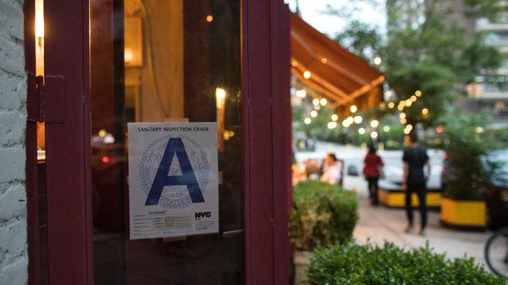
Predicting Restaurant Sanitation Grades
Cartney Thompson
IST 565 – Data Mining – Summer 2018
September 2018

Slide 2
Project Overview Research Question
The goal of this project is to predict the grade a restaurant receives after a sanitation inspection
Utilizing this information, the New York City Department of Health, consumers, and restaurant owners can:
Better understand common trends in the restaurant market in NYC with regards to health
Devote the necessary resources for inspections and health education before inspections take place
Understand which areas of sanitation inspection to focus on for higher grades

Slide 3
The Data Set
NYC Restaurant Inspections
https://www.kaggle.com/new-york-city/nyc-inspections/home
Nearly 400K rows of inspection data
18 attributes about each restaurant inspection
Restaurants across all five of NYC Boroughs
90K unique inspections across six years

Slide 4
Experimental Design
Prediction accuracy comparison across three different classification algorithms
Decision Trees
Naïve Bayes
Support Vector Machines

Slide 5
Data Cleaning
Organized Data Structure
Limited inspections to one row based upon inspection date
NA Values
Imputed inspection grades based upon inspection scores
Removed restaurants without inspection dates

Slide 6
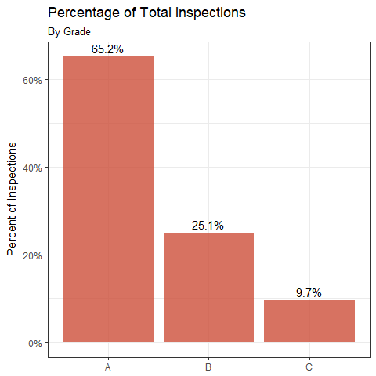
Exploratory Analysis Total Inspections by Grade

Slide 7
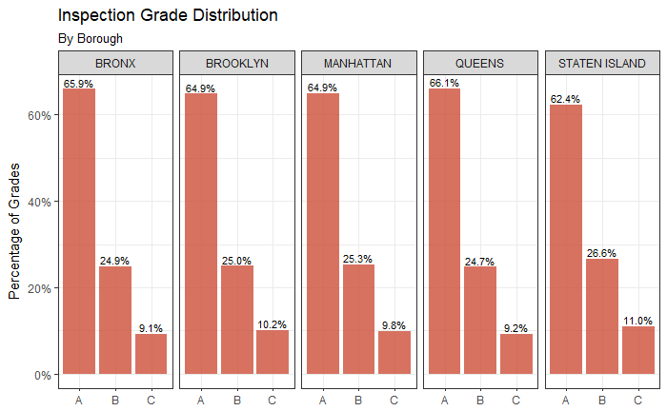
Exploratory Analysis Inspection Grade Distribution By Location

Slide 8
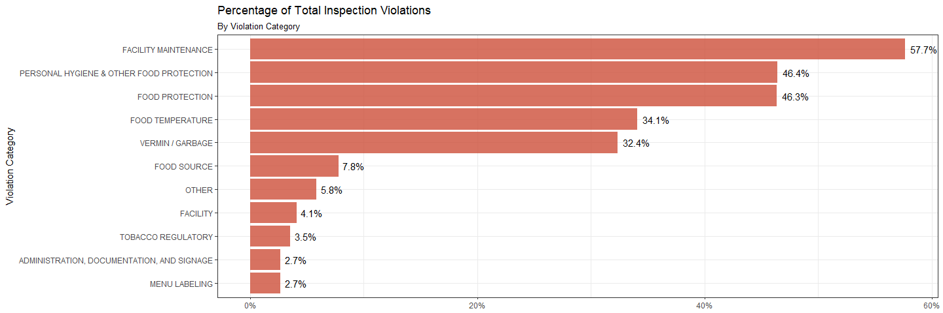
Exploratory Analysis Total Violations by Category

Slide 9
Data Preprocessing
Location
Borough restaurant is located
Cuisine Type
Type of cuisine offered
Violation Categories
Violation codes bucketed into 11 violation categories

Slide 10
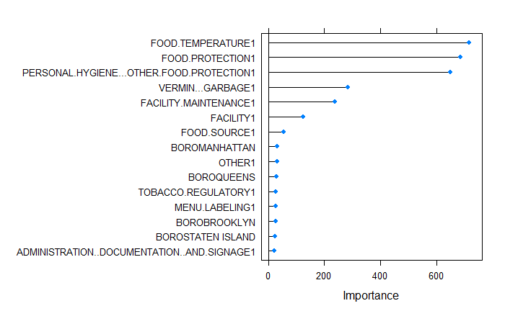
Data Preprocessing Features for Model
Removed Redundant and Insignificant Features
One-Hot Encoded Violation Categories
Split Data into Training (2/3) and Test (2/3)
Utilized Random Forests to determine most important features

Slide 11
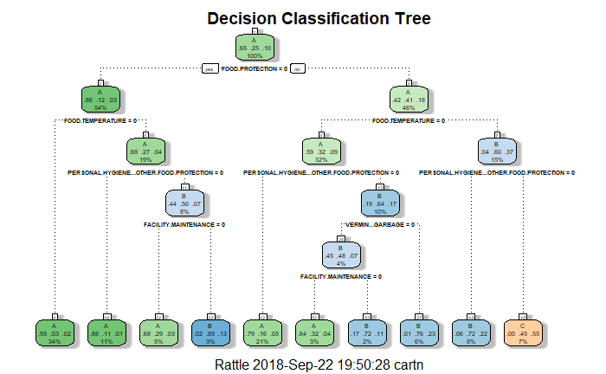
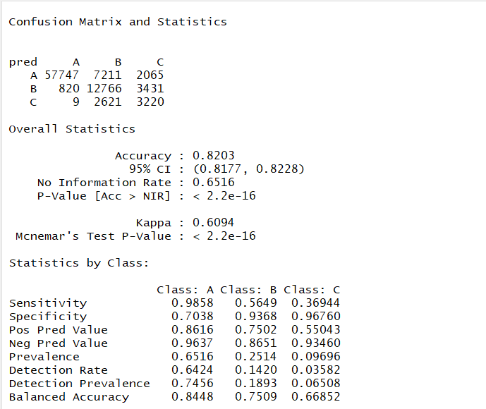
Project Experiment Decision Tree
Decision Tree
Prediction Accuracy = 82.0%
Test Data Accuracy = 82.3%

Slide 12
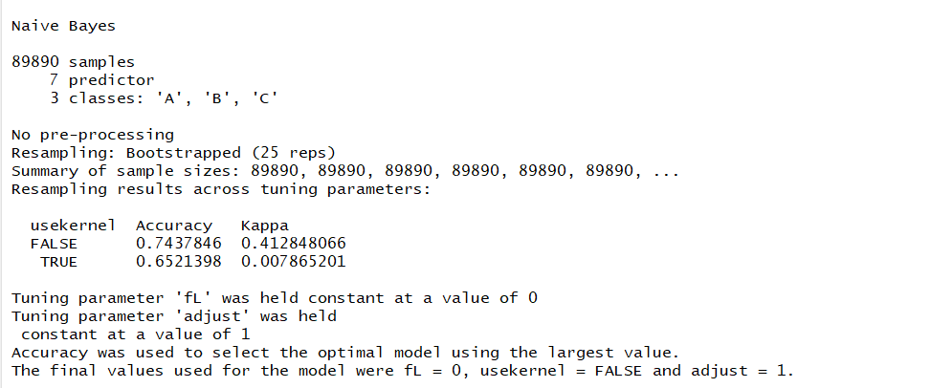
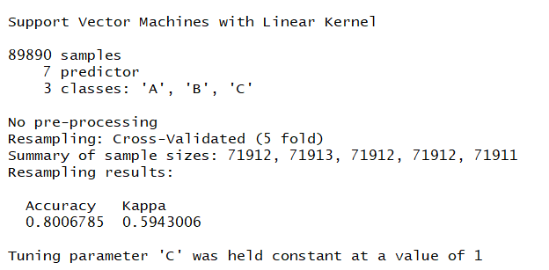
Project Experiment Naïve Bayes and Support Vector Machines (SVM)
Support Vector Machines Prediction Accuracy: 80.1%
Test Data Accuracy: 80.4
Naïve Bayes
Prediction Accuracy: 74.4%
Test Data Accuracy: 73.7%

Slide 13
Conclusion and Future Analysis
On the training and test data sets, Decision Tree was the most accurate algorithm followed by SVM, and Naïve Bayes.
Out of all variables, Food Protection, Food Temperature, Vermin/Garbage, and Person Hygiene were most important variables
Restaurant location and cuisine were not important factors in predicting inspection grades although would want to explore cuisine further

